Slide 1
Simulation of World’s Highest Jumping Robot
Junlin Chen
Sanskar Nalkande

Slide 2
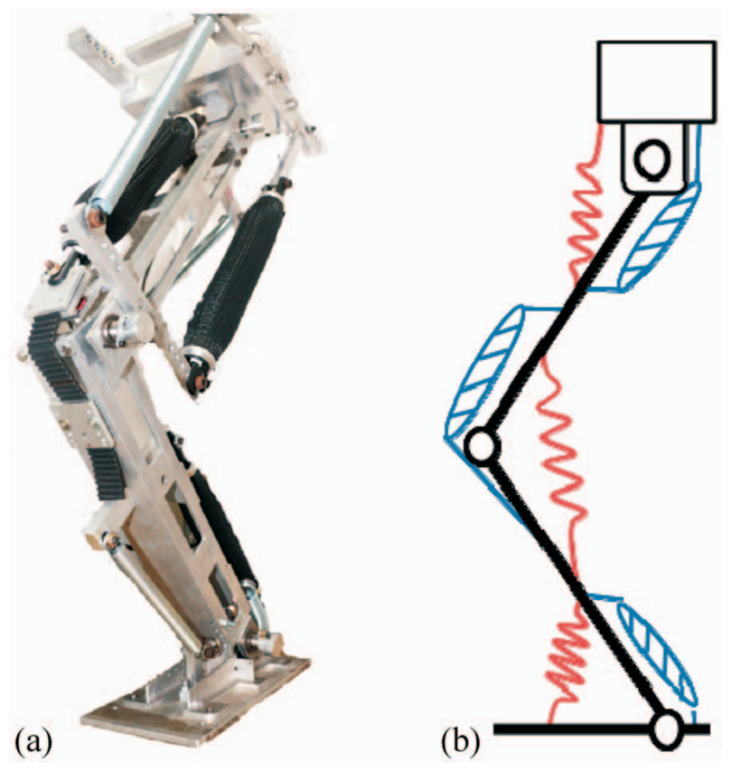
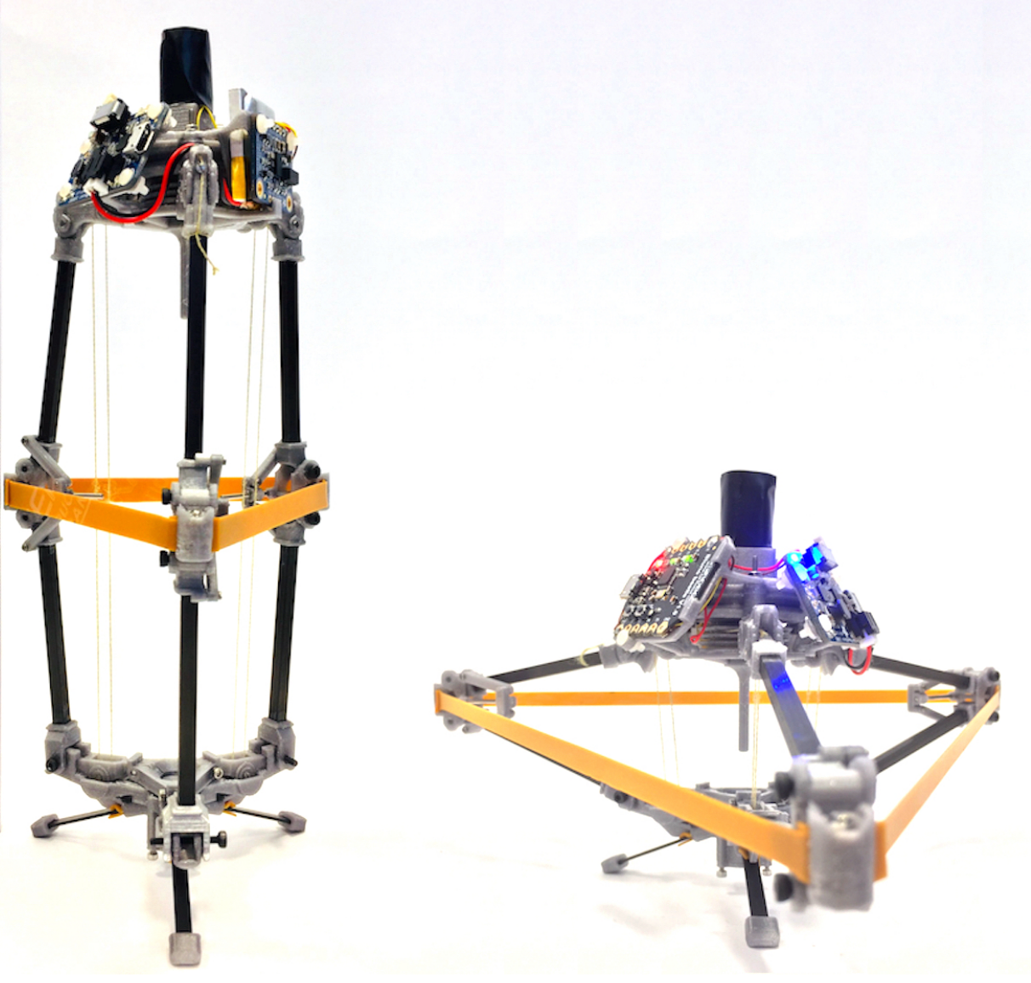
Previous Jumping Robots
Bio-mimic One-Legged Robot
Muscle, tendon, etc
Limited specific elastic energy
Demanding Structures
Engineered Multi-Legged Robot
Electric motors
Tension linkage
Still relatively limited elastic energy

Slide 3
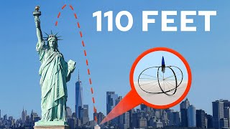

Slide 4
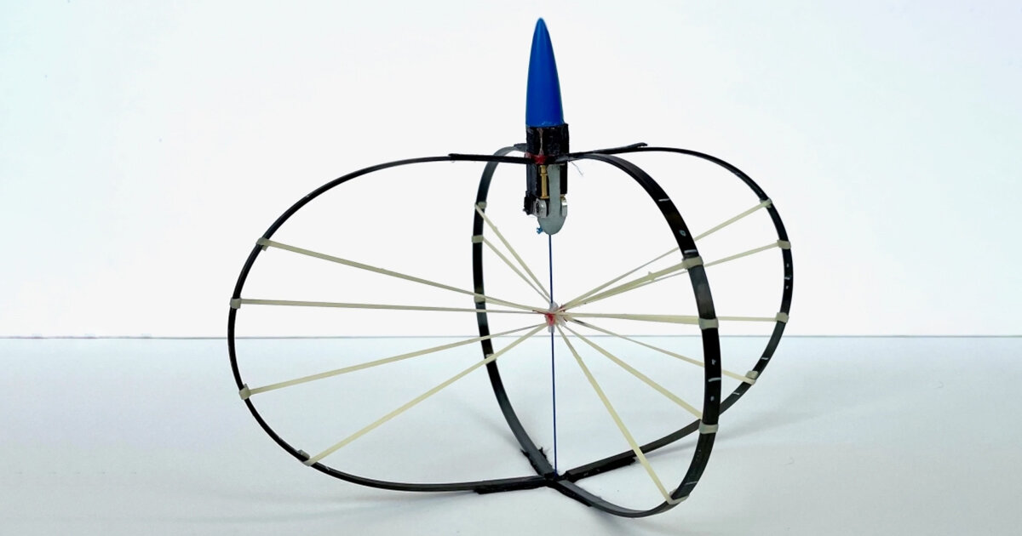
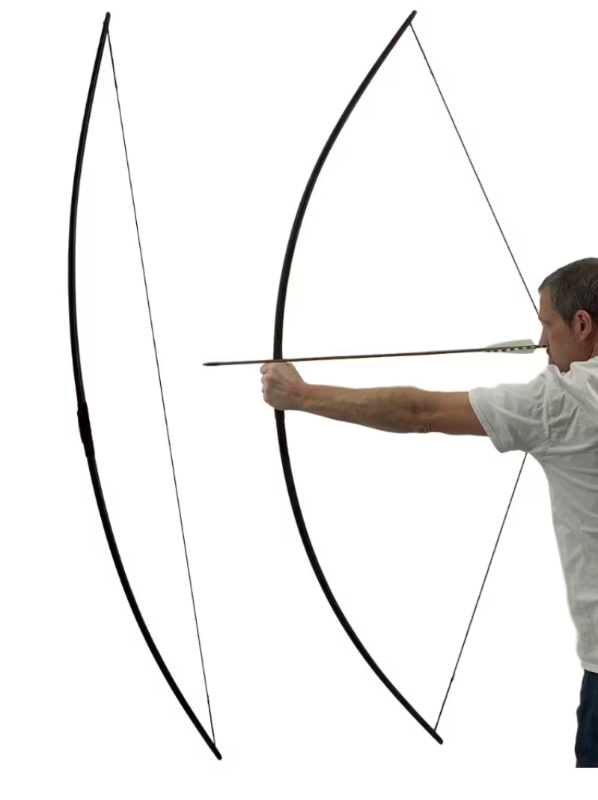
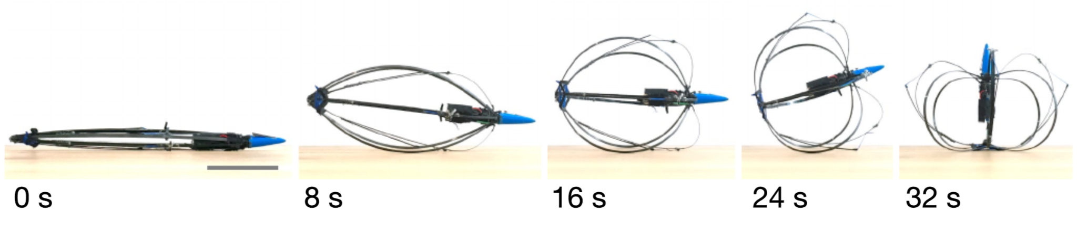
The Jumping Robot
Hybrid Tension-Compression Jumping Robot
Hybrid tension-compression
Engineered drive system
High specific energy
Minimal landing requirements

Slide 5
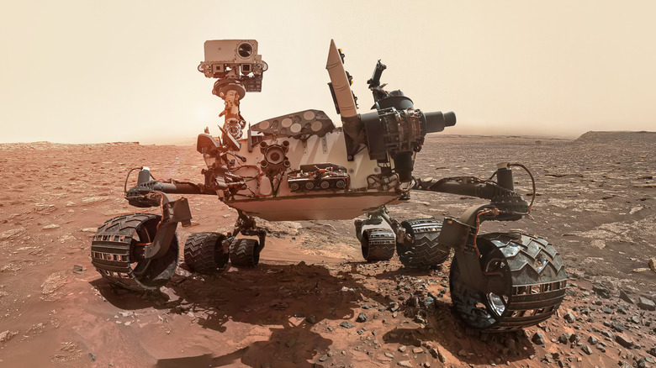

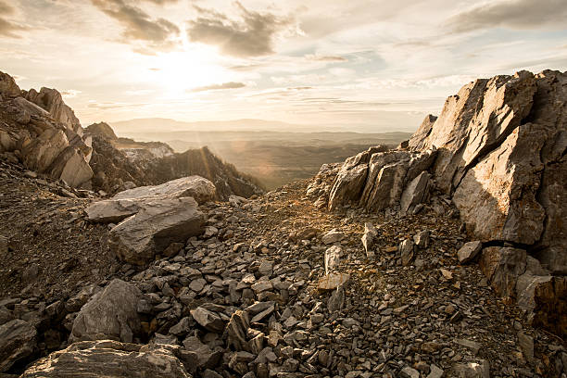
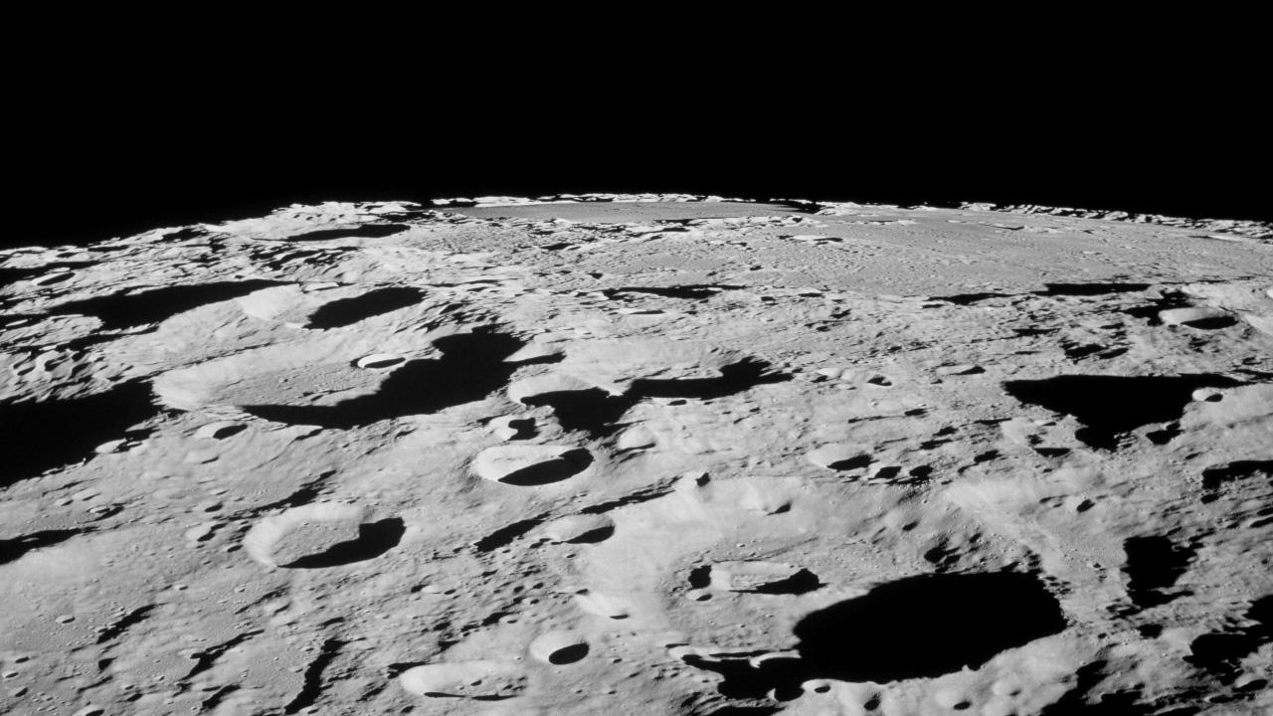
Importance of Our Project
Transportation on Rough Terrains
“Shoot” like arrow
No surface traction requirement
Extraterrestrial Exploration
Lightweight !
No limits on obstacle size

Slide 6
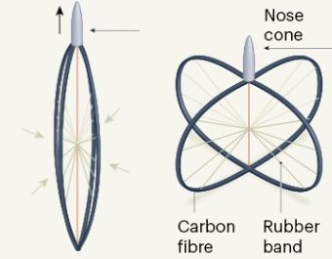
Methodology:
Setting Up the geometry
The geometry for our rods consist of:
Four Carbon Fibre Rod These rods store most of the energy needed for jumping in the stretched configuration.
Elastic Bands These bands in reality help in dissipating concentrated stress in the rods
Nose Cone A concentrated mass
Wire connecting cone and bottom Junction This wire is especially important since it will help us in setting the boundary conditions for stretched configuration easily.
Notes:
The two configurations in the image above are the unstretched and stretched versions respectively. In the first position, here, there is no stored energy in the system that can help the robot jump. But when the boundary conditions are set in a way that our robot is in the second position, the energy is stored in form of bending energy of the carbon fibre arms and stretching energy of the rubber bands.

Slide 7
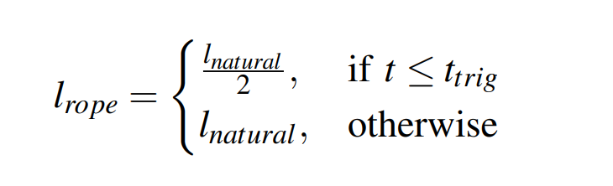
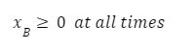
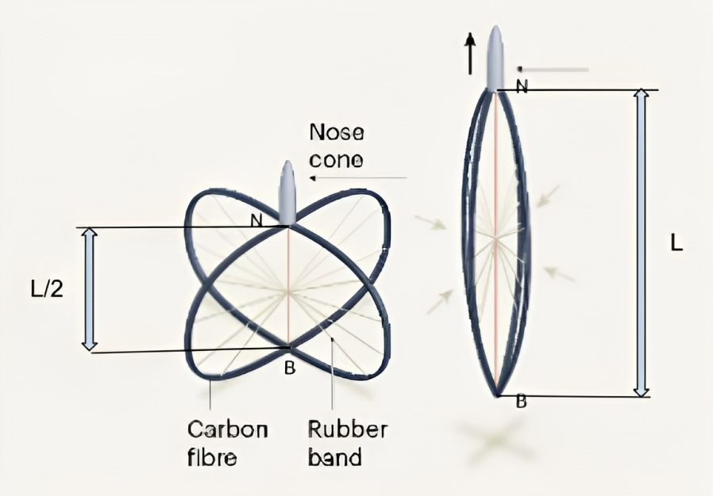
Methodology:
Actuation and Boundary Conditions
Actuation:
Boundary conditions:
Contact with the ground
Can be enforced in Dismech
Simulation Methods:
Discrete rod framework for the carbon rods
Simulate the rubber bands
Notes:
We can set the initial conditions on the robot such that our robot starts in the stretched configuration. This can be done by setting the length of the wire connecting the nose cone and the bottom junction. Suppose at time t = t_tig, the robot is launched, the initial condition before and after that time can be given by the following equation. It is also similarly described in the image. Coming to the boundary conditions, there is only one boundary condition here and that is contact with the ground. We

Slide 8
Sources:
[1] E. W. Hawkes et al., "Engineered Jumpers Overcome Biological Limits via Work Multiplication," Nature News, Apr. 27, 2022.
[2] NASA, "The Moon's Surface," Earth's Moon, Oct 3, 2017. https://moon.nasa.gov/resources/48/the-moons-surface/
[3] A. Macario-Rojas, B. Parslew, A. Weightman, and K. L. Smith, "CLOVER Robot: A Minimally Actuated Jumping Robotic Platform," Machines, vol. 10, p. 640, 2022. Available: https://doi.org/10.3390/machines10080640
[4] Slash Gear, "These NASA Mars Rover Inventions Could Be In Your Next Car”, Sep 15, 2022. https://www.slashgear.com/1009254/these-nasa-mars-rover-inventions-could-be-in-your-next-car/
[5] iStock, "Rocky Ground Pictures, Images and Stock Photos”, Sep 15, 2022. https://www.istockphoto.com/photos/rocky-ground
[6] Geographical, "Geo explainer: How are deserts formed?”, Sep 15, 2022. https://geographical.co.uk/science-environment/geo-explainer-how-are-deserts-formed-2
[7] I.-F. Lee, C.-I. Lin, H.-C. Wu, L.-C. Wu, P.-C. Lin, M.-H. Chiang, and W.-P. Shih, "Squat and Standing Motion of a Single Robotic Leg Using Pneumatic Artificial Muscles," Journal of Applied Science and Engineering, vol. 18, no. 4, pp. , Dec. 2015.

Slide 9
Thank you
Q&A Time

